Slide 1

INFRASTRUCTURE SOLUTIONS OF CLOUD
Module Number: 04
Module Name: Azure Active Directory and Azure Services

Slide 2
Syllabus:
Azure Active Directory and Azure Services
Implementing directory synchronization
Configuring a custom domain
Monitoring azure active directory
Adding a web application with azure AD
Adding a native application with azure AD
Configuring a graph API permission for an application
Configuring role instance count

Slide 3
Syllabus:
Azure Active Directory and Azure Services
Configuring role operating system settings
Configuring SSL
Configuring network traffic rules
Configuring remote desktop
Monitoring a cloud service
Configuring endpoint monitoring.

Slide 4
Azure Active Directory and Azure Services
Aim:
To equip the students to Manage resource Using Azure Active Directory

Slide 5
Azure Active Directory and Azure Services
Objectives:
The Objectives of this module are:
Differentiate the various Azure Services
Deploy synchronization pattern on Azure directory.
Modify a graph API permission in Azure Services
Design native application with azure AD in Virtual private Cloud
Implement a Monitoring a cloud service

Slide 6
Azure Active Directory and Azure Services
Outcomes:
At the end of this module, you are expected to:
Compare the various Azure Services
Design synchronization pattern on Azure Platform
Apply the control AD in Virtual private Cloud Application
Create appropriate Monitoring a cloud service in Azure Platform.

Slide 7
Table of Contents
Azure Active Directory and Azure Services
Configuring role operating system settings
Configuring SSL
Configuring network traffic rules
Configuring remote desktop
Monitoring a cloud service
Configuring endpoint monitoring.
Implementing directory synchronization
Configuring a custom domain
Monitoring azure active directory
Adding a web application with azure AD
Adding a native application with azure AD
Configuring a graph API permission for an application
Configuring role instance count

Slide 8
Azure Active Directory and Azure Services
Implementing Directory Synchronization
A hybrid infrastructure, which combines on-premises and cloud components, is common in many enterprises. Users can access resources with a single set of credentials by syncing their identities between local and cloud directories.
The process of synchronization involves
Making an object based on specific criteria
Keeping the thing up to date
When the conditions are no longer met, remove the object.

Slide 9
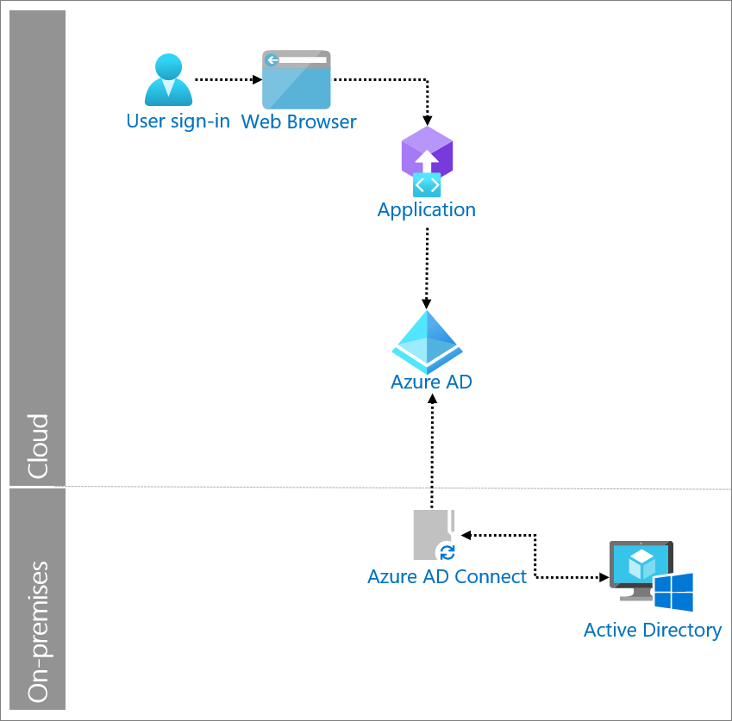
Azure Active Directory and Azure Services
Implementing Directory Synchronization
You need to synchronize identity data from your on-premises Active Directory environments to Azure AD.
Source: https://docs.microsoft.com/en-us/azure/active-directory/fundamentals/sync-directory

Slide 10
Azure Active Directory and Azure Services
Configuring A Custom Domain
Add your custom domain name to Azure AD
After you create your directory, you can add your custom domain name.
Sign in to the Azure portal using a Global administrator account for the directory.
Search for and select Azure Active Directory from any page. Then select Custom domain names > Add custom domain

Slide 11
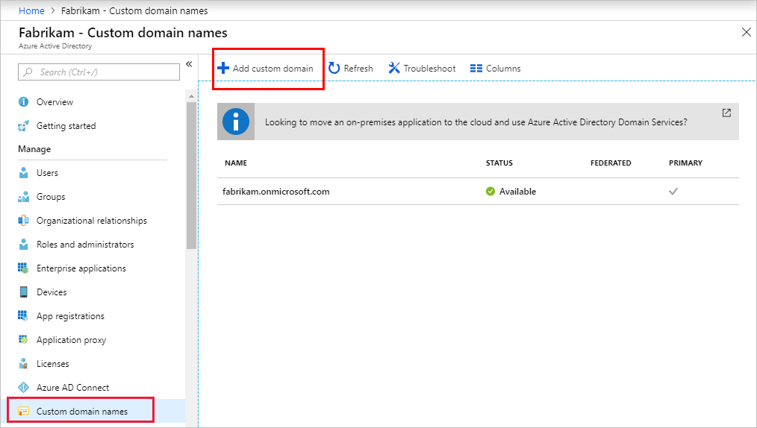
Azure Active Directory and Azure Services
Configuring A Custom Domain
Source: https://docs.microsoft.com/en-us/azure/active-directory/fundamentals/add-custom-domain

Slide 12
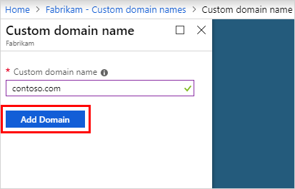
Azure Active Directory and Azure Services
Configuring A Custom Domain
In Custom domain name, enter your organization's new name, in this example, contoso.com. Select Add domain.
Source: https://docs.microsoft.com/en-us/azure/active-directory/fundamentals/add-custom-domain

Slide 13
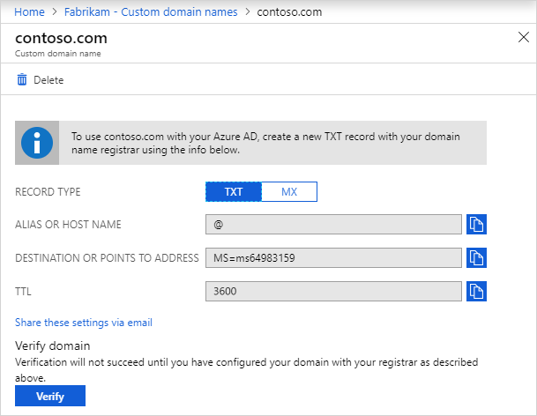
Azure Active Directory and Azure Services
Configuring A Custom Domain
The unverified domain is added. The contoso.com page appears showing your DNS information. Save this information. You need it later to create a TXT record to configure DNS.
Source: https://docs.microsoft.com/en-us/azure/active-directory/fundamentals/add-custom-domain

Slide 14
Azure Active Directory and Azure Services
Monitoring Azure Active Directory
We can increase the availability and efficiency of your applications and services with the aid of Azure Monitor. The telemetry from your cloud and on-premises systems can be collected, analyzed, and used to take action thanks to this comprehensive solution. With the aid of this data, you may better comprehend how your apps are operating and proactively spot problems before they impact the resources they rely on.

Slide 15
Azure Active Directory and Azure Services
Monitoring Azure Active Directory
A few instances of what Azure Monitor can be used for are as follows:
With Application Insights, problems across applications and dependencies may be found and diagnosed.
Link infrastructure problems to VM and container insights.
For thorough diagnostics and troubleshooting, use Log Analytics to delve into your monitoring data.
Automated actions can support operations at scale.
Utilize Azure dashboards and spreadsheets to create visualizations.
Utilize Azure Monitor Metrics to gather information from resources under observation.

Slide 16
Azure Active Directory and Azure Services
Monitoring Azure Active Directory
The figure that follows provides a high-level overview of Azure Monitor.
The two primary forms of data that Azure Monitor uses are metrics and logs, and these data storage are located in the middle of the figure.
The sources of monitoring data that fill these data repositories are shown on the left. The various tasks that Azure Monitor carries out with this data are shown on the right.
Analyzing, alerting, and broadcasting to external systems are some examples of this.

Slide 17
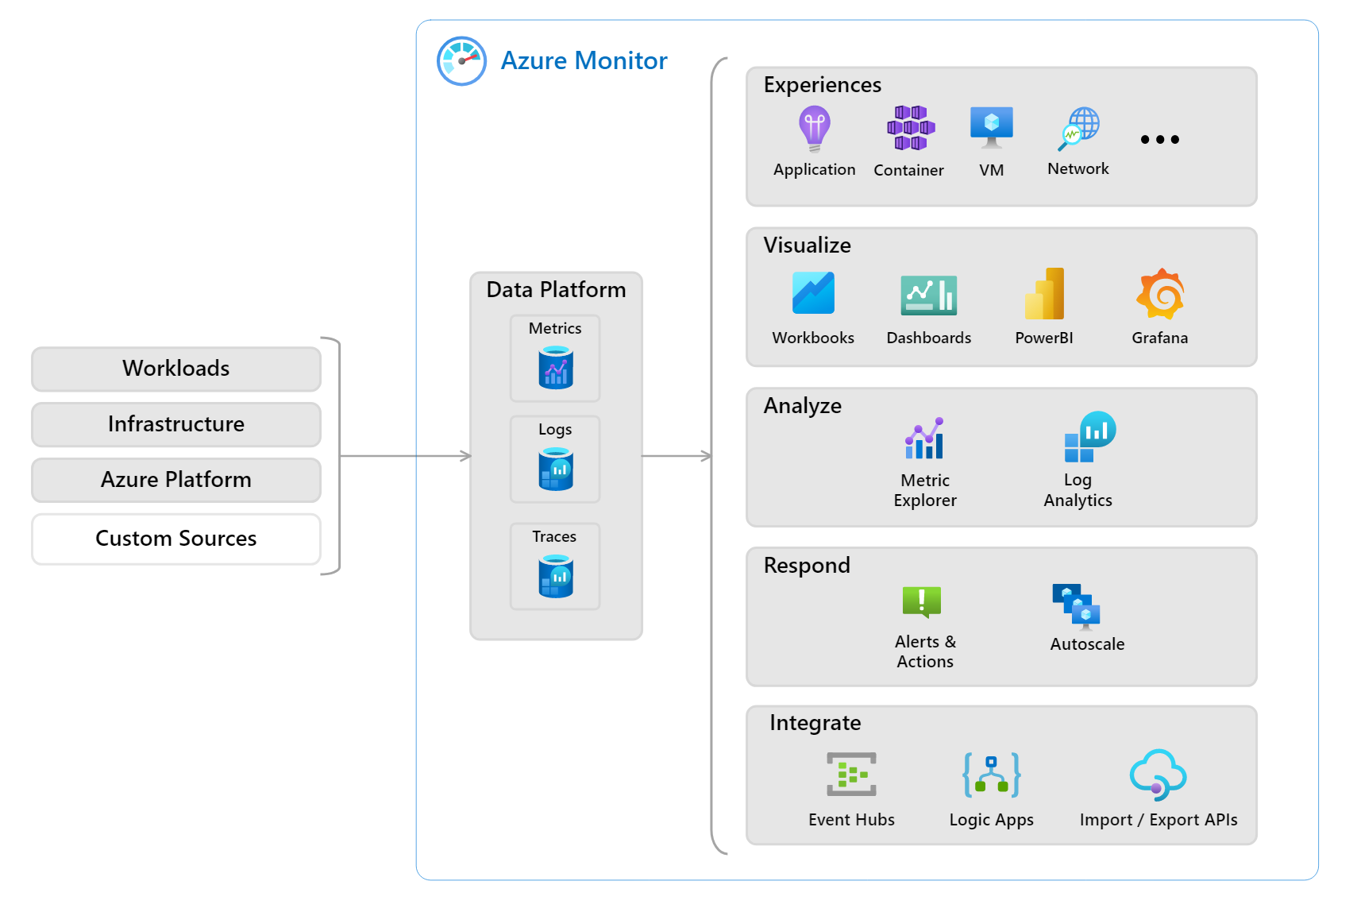
Azure Active Directory and Azure Services
Monitoring Azure Active Directory
Source: https://docs.microsoft.com/en-us/azure/azure-monitor/overview

Slide 18
Azure Active Directory and Azure Services
Monitoring Azure Active Directory
What information is gathered by Azure Monitor?
Azure Monitor can gather data from a variety of sources, including the platform itself, any operating system and services that your application depends on, and your application itself. Each of the following levels of data are gathered by Azure Monitor:
Information on the functionality and operation of the code you have developed, irrespective of the platform.
Monitoring information for the guest operating system: Information on the operating system that your application is using. The system may be operating on-site, in Azure, or another cloud.
Information about how an Azure resource is doing is known as Azure resource monitoring data. See What can you monitor with Azure Monitor? for a comprehensive list of the resources that contain metrics or logs.

Slide 19
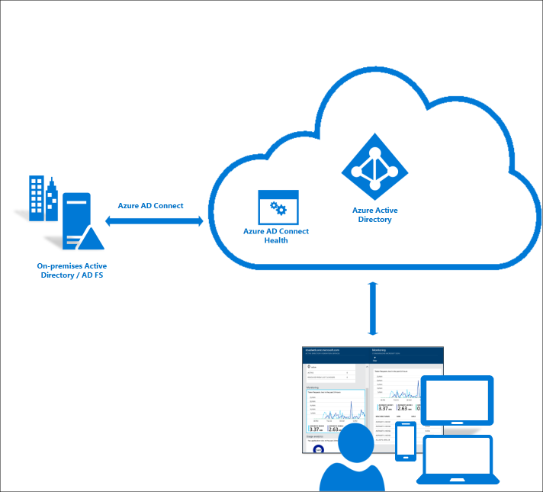
Azure Active Directory and Azure Services
Monitoring Azure Active Directory
Source: https://www.rebeladmin.com/2016/01/how-to-monitor-your-on-premises-ad-infrastructure-with-azure-ad-connect-health/

Slide 20
Azure Active Directory and Azure Services
Adding a web application with azure AD
We can sign users into your web app without writing any code thanks to App Service's integrated support for authentication and authorization. Our app's login and authorization processes are made simpler by using the optional App Service authentication/authorization module. We build on this architecture when you're ready for unique authentication and authorization.

Slide 21
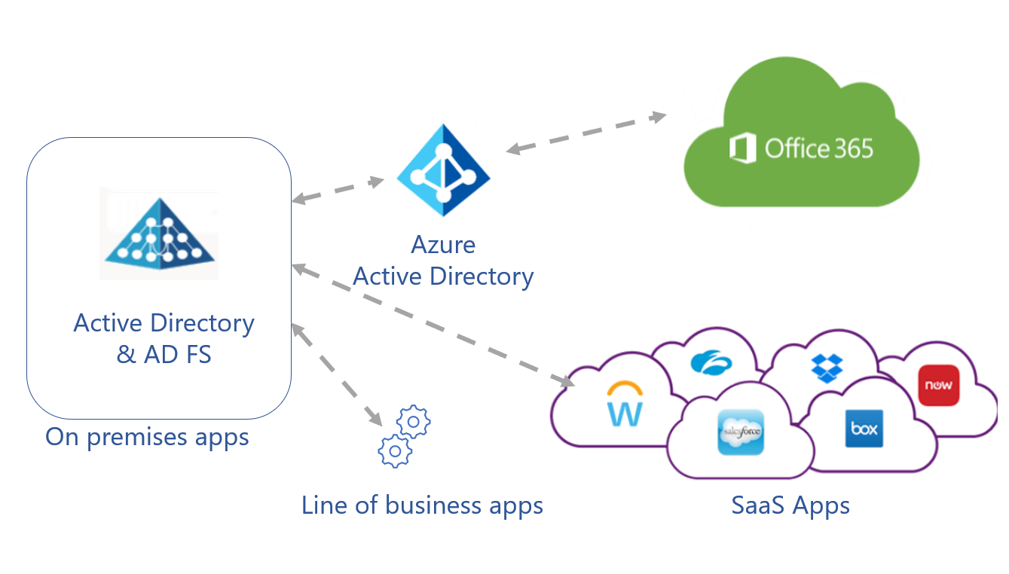
Azure Active Directory and Azure Services
Adding a web application
with azure AD
Once the app service has the authenticated identity, your system needs to connect to backend services as the app:
Use managed identity. If managed identity isn't available, then use Key Vault.
The user identity doesn't need to flow further. Any additional security to reach backend services is handled with the app service's identity.
Source: https://learn.microsoft.com/en-us/azure/active-directory/fundamentals/five-steps-to-full-application-integration-with-azure-ad

Slide 22
Azure Active Directory and Azure Services
Adding A Native Application With Azure AD
Sign in to the Azure portal.
Select the Directory + subscription filter in the top menu, and then select the directory that contains your Azure AD B2C tenant.
In the left menu, select Azure AD B2C. Or, select All services and search for and select Azure AD B2C.
Select App registrations, and then select New registration.
Enter a Name for the application. For example, nativeapp1.
Under Supported account types, select Accounts in any organizational directory or any identity provider.
Under Redirect URI, use the drop-down to select Public client/native (mobile & desktop).
Enter a redirect URI with a unique scheme. For example, com.onmicrosoft.contosob2c.exampleapp://oauth/redirect. There are important considerations when choosing a redirect URI:

Slide 23
Azure Active Directory and Azure Services
Adding A Native Application With Azure AD
With Azure AD, the Resource Owner flow is an additional option to the WS-Federation and OpenID Connect flows. Instead of displaying the Azure AD login page, this flow enables you to collect and validate a user's credentials (email and password). This approach is not advised for security and Single Sign-on (SSO) reasons, however Resource Owner flow can be helpful in Native mobile applications or to batch-process authentication with Azure AD.

Slide 24
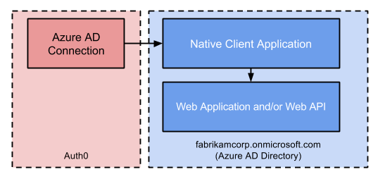
Azure Active Directory and Azure Services
Adding A Native Application With Azure AD
This configuration requires two applications: a Web Application and/or Web API, and a Native Client Application. From Azure AD's point of view, users will be authenticated using the Native Client Application to gain access to the Web Application and/or Web API.
Source: https://auth0.com/docs/authenticate/identity-providers/enterprise-identity-providers/azure-active-directory-native

Slide 25
Azure Active Directory and Azure Services
Configuring A Graph API Permission For An Application
In January 2022, the deprecated Microsoft Graph notifications API stopped returning data. Visit Microsoft Azure Notification Hubs for a different notification experience. Visit the blog post Retiring Microsoft Graph notifications API for additional details (beta).You must register your app with the Microsoft identity platform to support Microsoft accounts or work or school accounts, and then declare the API permissions that are necessary in order for your application service to connect with Microsoft Graph alerts.

Slide 26
Azure Active Directory and Azure Services
Configuring A Graph API Permission For An Application
In order to support Microsoft accounts as well as work or school accounts, register your application on the Microsoft Azure site. Your current applications will appear in the updated Azure portal if you already registered them on the Microsoft Application Portal.
See Register an application with the Microsoft identity platform for details on how to do so. Make sure to save the application ID and client ID somewhere accessible after registering your app. When you register your application for cross-device experiences in Partner Center for Windows, Android, or iOS clients, you'll require this ID afterwards.

Slide 27
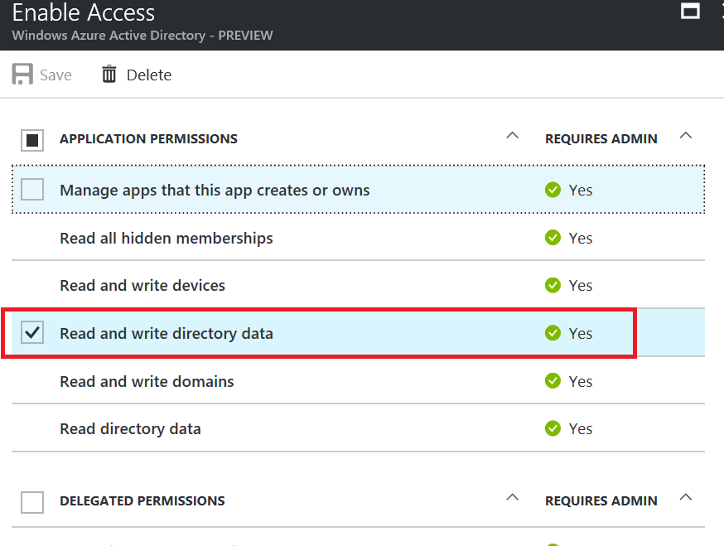
Azure Active Directory and Azure Services
Configuring A Graph API Permission For An Application
The final piece will handle the bulk of the work for us. We're planning to develop a new Web App / API application with the name "Querying App" for now (although native should probably work).The crucial step is to seize its Application-ID and grant it sufficient authority to generate users.
Source: https://vincentlauzon.com/2017/01/31/using-microsoft-graph-api-to-interact-with-azure-ad/

Slide 28
Azure Active Directory and Azure Services
Configuring Role Instance Count
Log in to the Azure website. Choose the Cloud Service (extended support) deployment for which scaling has to be configured. Choose the Scale blade.
The absolute count of instances will be set using the manual scale.
Make the scale Manual.
Enter the desired scale-up or scale-down instance count.
Choose Save.

Slide 29
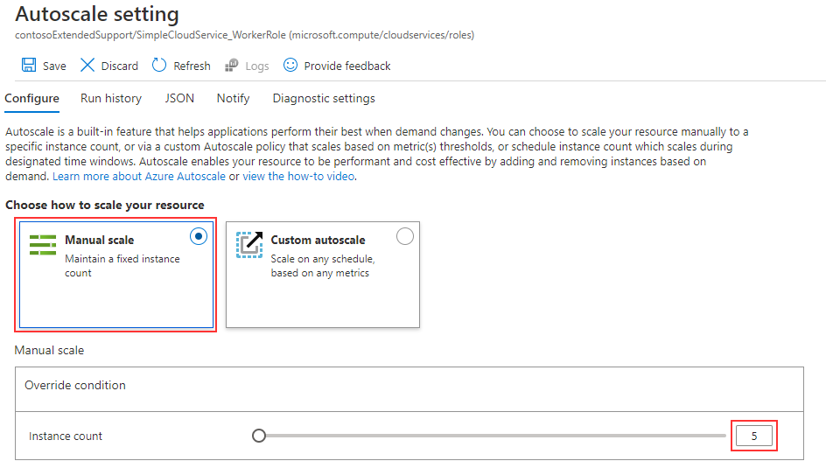
Azure Active Directory and Azure Services
Configuring Role Instance Count
Source: https://docs.microsoft.com/en-us/azure/cloud-services-extended-support/configure-scaling

Slide 30
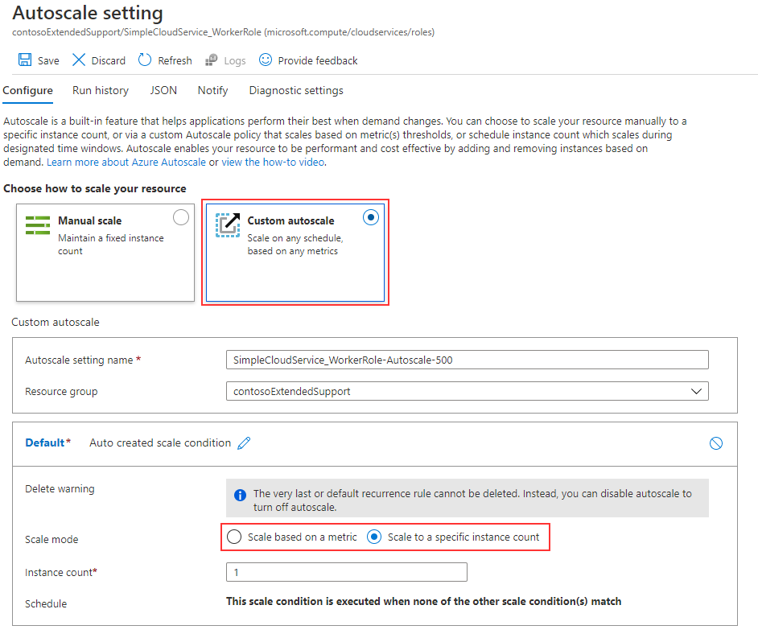
Azure Active Directory and Azure Services
Configuring Role Instance Count
Source: https://docs.microsoft.com/en-us/azure/cloud-services-extended-support/configure-scaling

Slide 31
Azure Active Directory and Azure Services
Configuring Role Operating System Settings
In order to undertake vulnerability assessments on your Azure compute resources, heed the advice of the Azure Security Center. To maintain the security settings of the operating system required by your company, you can also use Azure Resource Manager templates, custom operating system images, or Azure Automation State configuration. The Azure Automation Desired State Configuration and Microsoft virtual machine templates may help fulfil and maintain the security standards.

Slide 32
Azure Active Directory and Azure Services
Configuring Role Operating System Settings
Use Azure role-based access control (Azure RBAC) if you're employing custom pictures to guarantee that only authorised users can access the files. You can distribute your photographs to other users, service principals, or AD groups inside your company by using a shared image gallery. Store container images in Azure Container Registry and use Azure RBAC to restrict access to them to only approved users.

Slide 33
Azure Active Directory and Azure Services
Configuring Role Operating System Settings
A configuration management service for Desired State Configuration (DSC) nodes in any cloud or on-premises datacenter is Azure Automation State Configuration. It is simple to onboard machines, give them declarative configurations, and read reports that demonstrate how well each unit complies with your defined desired state.

Slide 34
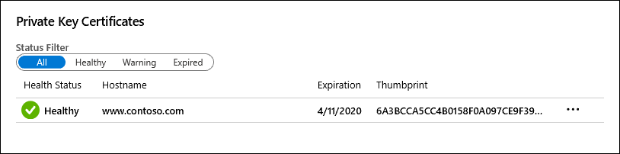
Azure Active Directory and Azure Services
Configuring SSL
In the Azure portal, from the left menu, select App Services > <app-name>.
From the left navigation of your app, select TLS/SSL settings, then select Private Key Certificates (.pfx) or Public Key Certificates (.cer).
Find the certificate you want to use and copy the thumbprint.
Source: https://docs.microsoft.com/en-us/azure/app-service/configure-ssl-certificate-in-code

Slide 35
Azure Active Directory and Azure Services
Configuring SSL
You get the subsequent error when adding a TLS binding:
"Binding SSL failed to be added. Because another VIP is already using the certificate, it cannot be set for an existing VIP.“
Cause
If you use numerous IP-based TLS/SSL bindings for the same IP address across various apps, an issue might arise. For instance, app A uses an outdated certificate for its IP-based TLS/SSL binding. App B has a fresh certificate for the same IP address and an IP-based TLS/SSL binding. This problem occurs when you update an app's TLS binding with a new certificate because another app is using the same IP address.

Slide 36
Azure Active Directory and Azure Services
Configuring network traffic rules
Network traffic to and from Azure resources in an Azure virtual network can be filtered using a network security group.
Network traffic is filtered by IP address, port, and protocol using security rules that are part of network security groups.
Security rules are applied to resources deployed in a subnet when a network security group is connected to it.

Slide 37
Azure Active Directory and Azure Services
Configuring network traffic rules
Create a security rule that allows ports 80 and 443 to the myAsgWebServers application security group. In Add inbound security rule page, enter or select this information:
Setting Value
Source Leave the default of Any.
Source port ranges Leave the default of (*).
Destination Select Application security group.
Destination application security groups Select myAsgWebServers.
Service Leave the default of Custom.
Destination port ranges Enter 80,443.
Protocol Select TCP.
Action Leave the default of Allow.
Priority Leave the default of 100.
Name Enter Allow-Web-All.

Slide 38
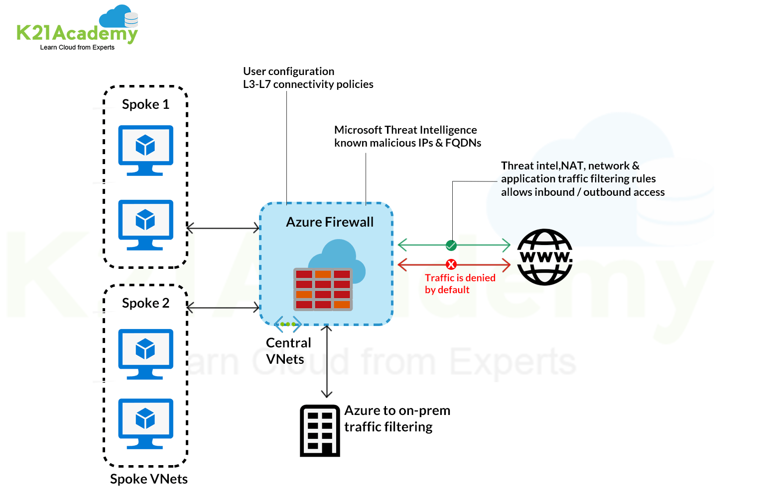
Azure Active Directory and Azure Services
Configuring network traffic rules
Source: https://k21academy.com/microsoft-azure/az-500/azure-firewall-vs-nsg/

Slide 39
Azure Active Directory and Azure Services
Configuring network traffic rules
Microsoft's fully managed Azure Network Security Groups service helps to sanitise traffic to and from Azure VNet.
Users can accept or reject the security rules that make up the Azure NSG as they see fit. A 5-tuple hash is used to evaluate these rules.
The source port number, IP addresses, destination IP addresses, and port numbers are among the values used in the 5-tuple hash.
It operates on layers 3 and 4 of the OSI model and makes it very easy to link Network Security Groups with a VNet or VM network interface.

Slide 40
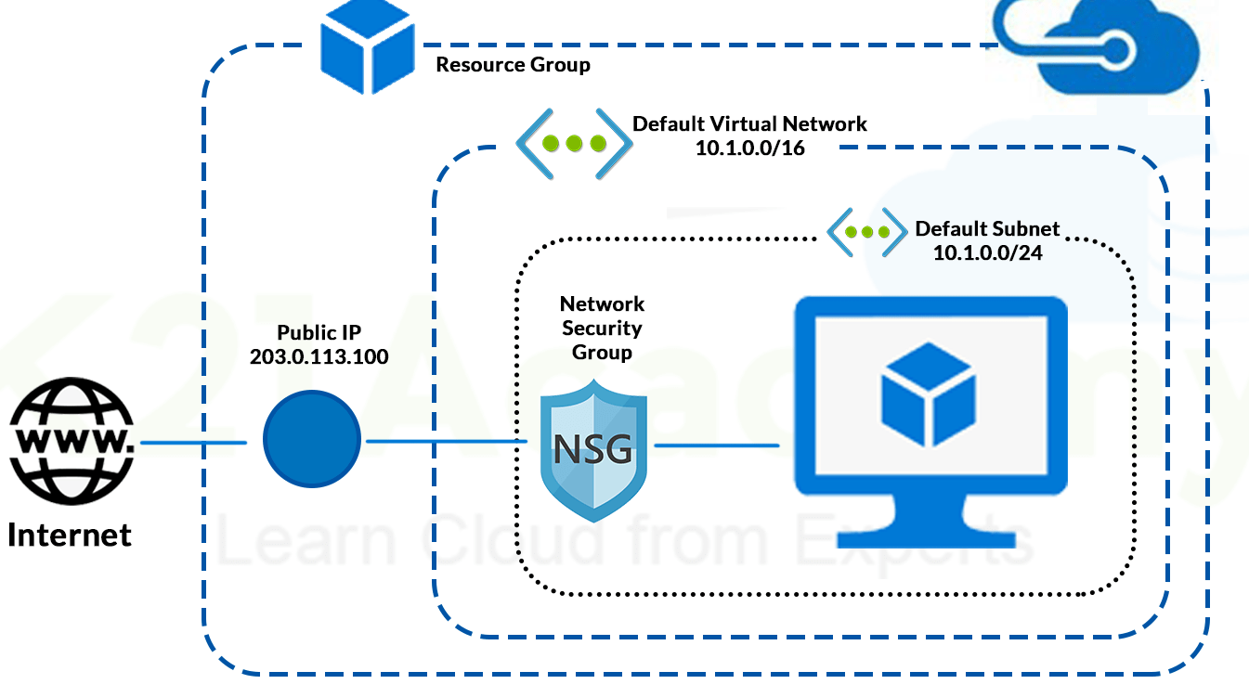
Azure Active Directory and Azure Services
Configuring network traffic rules
Source; https://k21academy.com/microsoft-azure/az-500/azure-firewall-vs-nsg/

Slide 41
Azure Active Directory and Azure Services
Configuring network traffic rules
Microsoft's Azure Network Security Group (NSG) is a fantastic tool for safeguarding virtual networks. Administrators may easily manage, filter, direct, and limit different network traffic flows using this.
To establish Azure Network Security Group, you can set several inbound and outgoing rules to allow or disallow a certain type of traffic. You must build and set up each rule in an Azure Network Security Group before using it.
We can specify any rules needed based on the circumstance, such as whether or not the traffic moving over the network is secure and needs to be allowed.

Slide 42
Azure Active Directory and Azure Services
Configuring Remote Desktop
Windows 10, version 1607 or later, must be installed on both the local and remote PCs. An Azure AD-joined PC running an earlier version of Windows 10 is not supported for remote connections.
If using Windows 10, version 1607 and above, your local PC (from which you are connecting) must be either Azure AD-joined or Hybrid Azure AD-joined, or Azure AD registered, if using Windows 10, version 2004 and above. It is not possible to connect remotely to a Windows 10 or Azure AD-joined PC from an unjointed or non-Windows 10 device.
A shared Azure AD tenant must contain both the local PC and the remote PC. Remote desktop does not support Azure AD B2B guests.

Slide 43
Azure Active Directory and Azure Services
Configuring Remote Desktop
Ensure Remote Credential Guard, a new feature in Windows 10, version 1607, is turned off on the client PC you're using to connect to the remote PC.
On the PC you want to connect to:
Open system properties for the remote PC.
Enable Allow remote connections to this computer and select Allow connections only from computers running Remote Desktop with Network Level Authentication.
Allow remote connections to this computer.

Slide 44
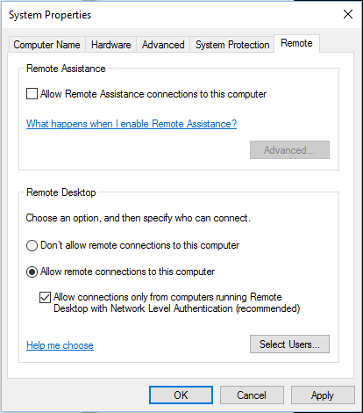
Azure Active Directory and Azure Services
Configuring Remote Desktop
If the user who joined the PC to Azure AD is the only one who is going to connect remotely, no other configuration is needed. To allow more users or groups to connect to the PC, you must allow remote connections for the specified users or groups. Users can be added either manually or through MDM policies:
Source: https://docs.microsoft.com/en-us/windows/client-management/connect-to-remote-aadj-pc

Slide 45
Azure Active Directory and Azure Services
Monitoring A Cloud Service
You can increase the availability and efficiency of your applications and services with the aid of Azure Monitor.
The telemetry from your cloud and on-premises systems can be collected, analyzed, and used to take action thanks to this comprehensive solution.
With the aid of this data, you may better comprehend how your apps are operating and proactively spot problems before they impact the resources they rely on.

Slide 46
Azure Active Directory and Azure Services
Monitoring A Cloud Service
A few instances of what Azure Monitor can be used for are as follows:
With Application Insights, problems across applications and dependencies may be found and diagnosed.
Link infrastructure problems to VM and container insights.
For thorough diagnostics and troubleshooting, use Log Analytics to delve into your monitoring data.
Automated actions can support operations at scale.
Utilize Azure dashboards and spreadsheets to create visualizations.
Utilize Azure Monitor Metrics to gather information from resources under observation.
Utilize change analysis to look at change data for routine monitoring or issue triage.

Slide 47
Azure Active Directory and Azure Services
Monitoring A Cloud Service
The figure that follows provides a high-level overview of Azure Monitor.
The two primary forms of data that Azure Monitor uses are metrics and logs, and these data storage are located in the middle of the figure.
The sources of monitoring data that fill these data repositories are shown on the left. The various tasks that Azure Monitor carries out with this data are shown on the right. Analyzing, alerting, and broadcasting to external systems are some examples of this.

Slide 48
Azure Active Directory and Azure Services
Monitoring A Cloud Service
Source: https://docs.microsoft.com/en-us/azure/azure-monitor/overview

Slide 49
Azure Active Directory and Azure Services
Configuring Endpoint Monitoring.
Monitoring web applications and back-end services to make sure they are available and operating as intended is a good practice and frequently a business need.
However, monitoring cloud-based services can occasionally be more challenging than monitoring on-premises services.
For instance, the hosting environment is not entirely under your control, and the services are frequently dependent on other services offered by platform suppliers and other companies.

Slide 50
Azure Active Directory and Azure Services
Configuring Endpoint Monitoring.
Network latency, the speed and availability of the underlying computing and storage systems, as well as the network bandwidth between them, are just a few of the variables that have an impact on cloud-hosted applications.
Any of these causes can result in a whole or partial failure of the service.
In order to achieve the needed degree of availability, you must regularly check that the service is functioning properly. This check may be included in your service level agreement (SLA).

Slide 51
Azure Active Directory and Azure Services
Configuring Endpoint Monitoring.
Send requests to an application endpoint to implement health monitoring. The application should carry out the required verifications and provide a status update.
Usually, a health monitoring check combines two elements: the tests that, if any, the application or service ran in response to the endpoint's request for health information.
Analysis of the results by the tool or framework that performs the health verification check.

Slide 52
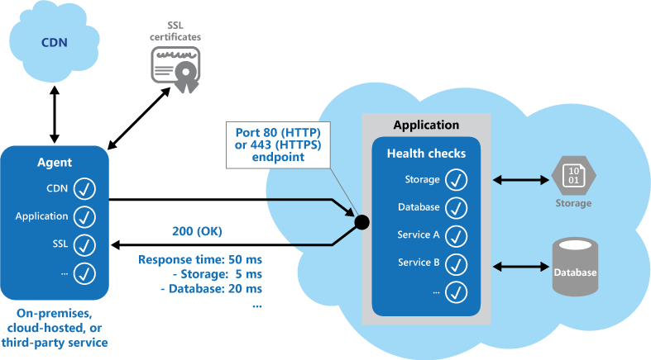
Azure Active Directory and Azure Services
Configuring Endpoint Monitoring.
The response code indicates the status of the application and, optionally, any components or services it uses. The latency or response time check is performed by the monitoring tool or framework. The figure provides an overview of the pattern.
Source: https://docs.microsoft.com/en-us/azure/architecture/patterns/health-endpoint-monitoring

Slide 53

Azure Active Directory and Azure Services
Summary
In this module, we have studied Azure Active Directory and Azure Services , A hybrid infrastructure, which combines on-premises and cloud components, is common in many enterprises. Users can access resources with a single set of credentials by syncing their identities between local and cloud directories.
With Azure AD, the Resource Owner flow is an additional option to the WS-Federation and OpenID Connect flows. Instead of displaying the Azure AD login page, this flow enables you to collect and validate a user's credentials (email and password). This approach is not advised for security and Single Sign-on (SSO) reasons, however Resource Owner flow can be helpful in Native mobile applications or to batch-process authentication with Azure AD.
In order to undertake vulnerability assessments on your Azure compute resources, heed the advice of the Azure Security Center. To maintain the security settings of the operating system required by your company, you can also use Azure Resource Manager templates, custom operating system images, or Azure Automation State configuration.

Slide 54
Azure Active Directory and Azure Services
Self Assessment ( Quiz)
Q1. How many types of groups are available in Active Directory.
2
3
4
5
Answer: a

Slide 55
Azure Active Directory and Azure Services
Q2. A _________ role is a virtual machine instance running the Microsoft IIS Web server that can accept and respond to HTTP or HTTPS requests.
a) Web
b) Server
c) Worker
d) Client
Answer: a

Slide 56
Azure Active Directory and Azure Services
Q3. There are ........... group scopes in Active Directory?
0
1
2
3
Answer: d)

Slide 57
Azure Active Directory and Azure Services
Q4. Which of the following is not one of the four divisions or container structures in Active Directory?
Webs
Forests
Domain
Sites
Answer: a)

Slide 58
Azure Active Directory and Azure Services
Q5. Active Directory is a technology created by ..................
Microsoft
IBM
Google
None Of The Above
Answer: a

Slide 59
Azure Active Directory and Azure Services
Q6. The technology used to distribute service requests to resources is referred to as _____________
Load Scheduling
Load Performing
Load Balancing
None
Answer: c

Slide 60
Azure Active Directory and Azure Services
Q7. When planning to migrate a public website to Azure, you must plan to pay monthly usage costs.
No change is needed
Deploy a VPN
pay to transfer all the website data to Azure
reduce the number of connections to the website
Answer- a)

Slide 61
Azure Active Directory and Azure Services
Q8. Active Directory and a Windows-based file server are not required to implement ________ on client Windows computers.
Windows 2000
Internet Explorer
Windows Registry
Roaming user profile
Answer: d)

Slide 62
Azure Active Directory and Azure Services
Q9. Which load balancer operates at both individual request level (Layer 7) and connection level (Layer 4) only?
(a) Application Load Balancers
(b) Network Load Balancers
(c) Storage Load Balancers
(d) Classic Load Balancers
Answer: d

Slide 63
Azure Active Directory and Azure Services
10. Major Components of Active Directory are ................
Tree
Site
Domain
All of the above
Answer: d

Slide 64

Azure Active Directory and Azure Services
Activity
Activity Type: Offline Duration: 60 Minutes
Description: Case Study: AZURE AD Comparison with AWS IAM

Slide 65

Azure Active Directory and Azure Services
Subjective Assessment
Bring out the difference between active Directory and azure active Directory ?
Configure A Graph API Permission For An Application on azure platform.
Discuss the Infrastructure Monitoring Azure Cloud Service.

Slide 66

Azure Active Directory and Azure Services
External Resources
https://riptutorial.com/ebook/azure-active-directory
https://www.pdfdrive.com/what-is-azure-active-directory-e33409121.html

Slide 67
Azure Active Directory and Azure Services
Document Links
Topics | URL | Notes
AZURE AD | https://azure.microsoft.com/en-in/services/active-directory/ | This link explain AZURE AD
Azure Monitoring | https://azure.microsoft.com/en-in/services/monitor/ | This link explains Azure Monitoring

Slide 68
Azure Active Directory and Azure Services
Video Links
Topics | URL | Notes
AZURE AD | https://www.youtube.com/watch?v=OQwQmikCLs4 | This video explains AZURE AD
Azure Monitoring | https://www.youtube.com/watch?v=MbyS0a2NCnk | You will learn Azure Monitoring
Configuring network traffic rules | https://www.youtube.com/watch?v=feQvnIUJ3Iw | This video explains Configuring network traffic rules

Slide 69
Azure Active Directory and Azure Services
E-Book Links
Topics | URL | Page Number
Azure Active Directory and Azure Services | ·https://www.unisys.com/siteassets/collateral/white-paper/wp_200701_azureadintegrationwithmicrosoftad.pdf | All pages

